Slide 1


Leading the way in the cloud with Intelligent Data Management
COMMVAULT’S SaaS LINE METALLIC® for Microsoft365 and Kubernetes data protection

Slide 2

NetApp and Commvault – Better Together
Key Milestones
Commvault & NetApp came together over 15 years ago to offer -
SIMPLE integrated data management & protection solutions that provide companies the ability to SIMPLY deliver business outcomes around…
Risk Reduction & Security
Cost Reduction
Operational Efficiency
Enterprise Agility
Aug - Metallic SaaS for Kubernetes backup
2022
June - Metallic SaaS for Microsoft 365 backup
2018
Commvault IntelliSnap for NetApp expands co-selling flexibility
Commvault adds support for NetApp SolidFire®
Launch of Commvault Backup Appliance with NetApp
2015
Relaunch of NetApp / Commvault Partnership with NetApp Resale of Commvault Complete
New User experience
More Snapshot Integration
2013
2011
Commvault support for clustered Data ONTAP®
OEM agreement for NetApp SnapProtect® (predecessor to Commvault IntelliSnap for NetApp)

Slide 3
Ushering the Cloud Era with Intelligent Data Services
Commvault’s trajectory of success
26 years
as a pioneer in data management
1998 - 2010
2010 - 2019
Now & Forward
10 consecutive years
as Gartner Magic Quadrant leader
Backup &
Recovery
Patented no-limits architecture for data protection
Data Management Intelligence
AI/ML intelligence and scale to enable use case and workload expansion
Unified Data Management Platform
Intelligent Data Services (Data Protection, Security, GRC)
Multi-Cloud, On-Prem and Edge
SaaS, cloud and legacy application workloads
Delivered as software and SaaS
>1,000
issued patents
98%
customer support satisfaction
100,000+
organizations rely on Commvault
>2.5 exabyte
moved to the cloud
Notes:
Commvault helps NetApp customers to usher in the cloud era with Intelligent data services. We use the unified data management platform approach offering data protection across mutli-cloud, on-prem and edge. Our technology is offered as a software as well as a SaaS offering.
We are leading the way in the cloud as a pioneer in data management for 26 years. We have been a consistent leader in the Gartner MQ over 10 consecutive years, having issued 1000+ patents in the space. Over 100,000 organizations rely on Commvault and we have tight relationships with cloud providers, having already moved more than 2.5 exabyte data to the cloud. We ensure that our customers reap the benefits of our technology and services maintaining 98% satisfaction ratings.

Slide 4


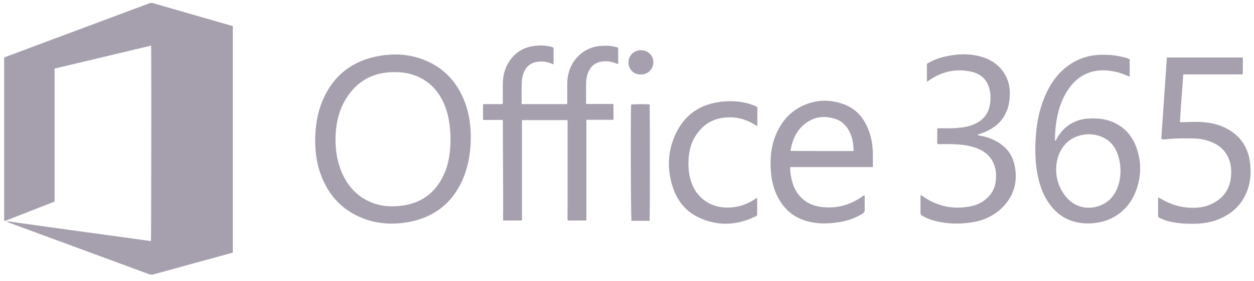





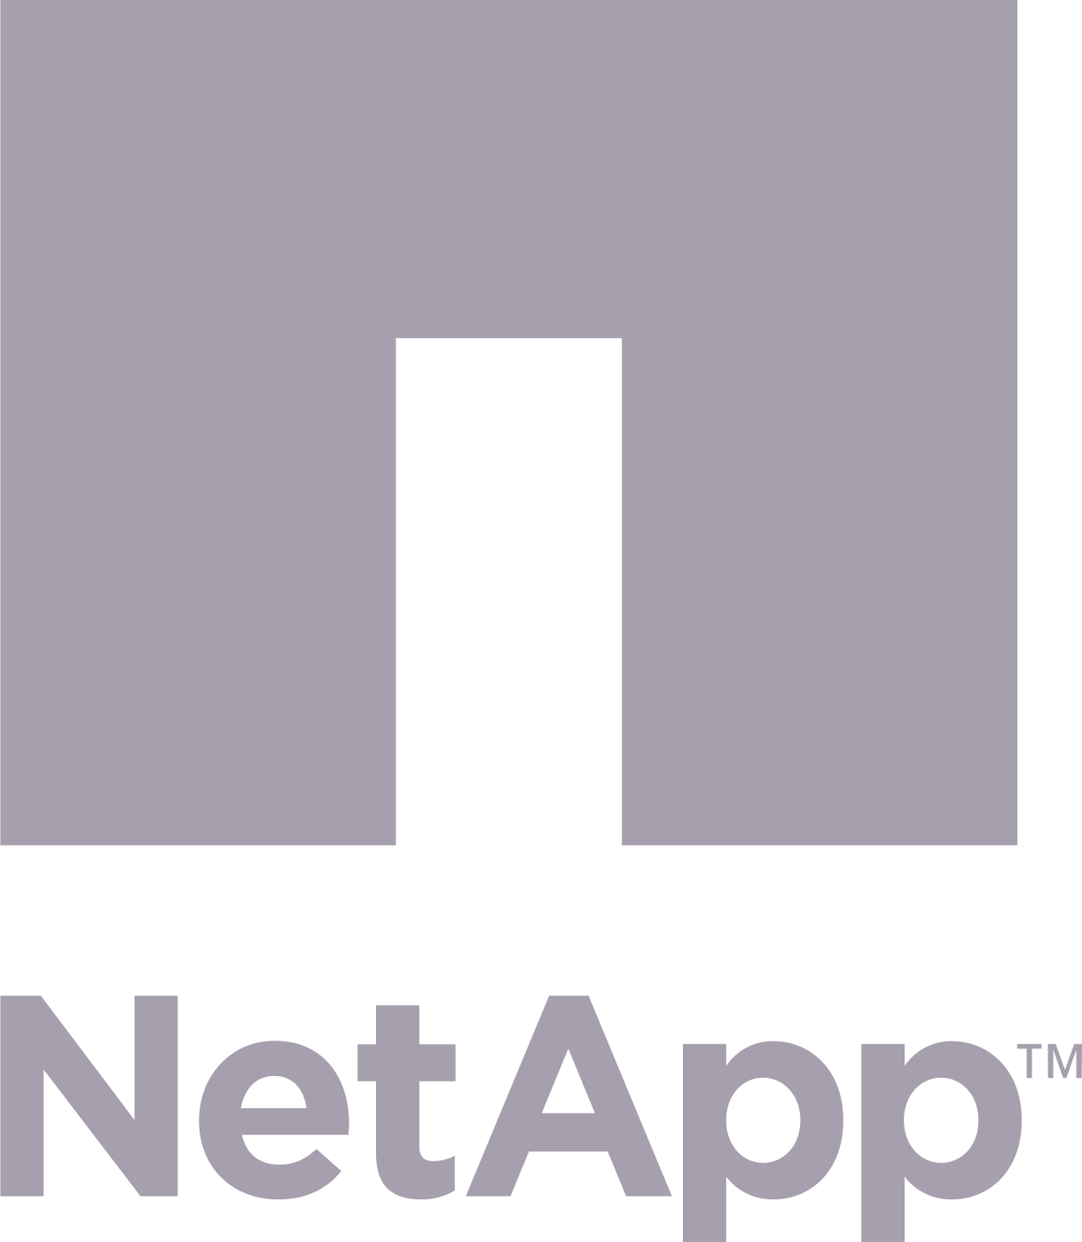
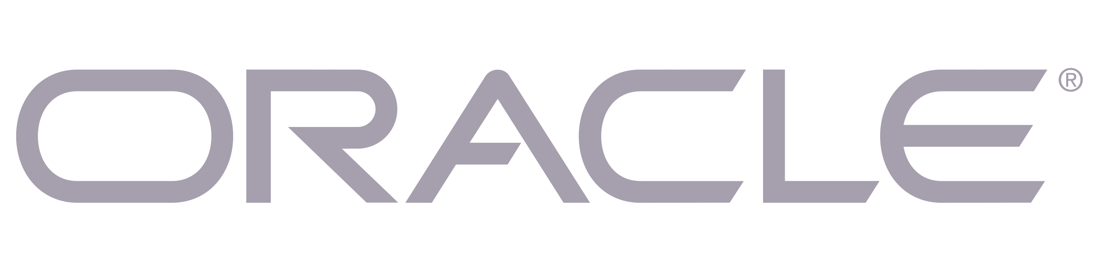

The Data World is Accelerating Digital Transformation
DATA
CENTRIC
SaaS is outpacing traditional applications
23%
CAGR 2020 – 2025
(post Covid)¹
BUSINESS TRANSFORMATION
VOLUME OF DATA
Managing legacy
data while transforming
INFRASTRUCTURE
CENTRIC
Fragmentation and data silos
TIME
1 Source: IDC report WW global datasphere forecast , March 2021
Notes:
Global data creation and replication is currently experiencing a compound annual growth rate (CAGR) of 23% over the 2020-2025 forecast period. IDC says corporate data repositories are more fragmented than ever, with continued annual data growth of 40–50% and rapid proliferation of cloud storage, mobile devices, software-as-a-service applications, and open source innovations. (Source: IDC report WW global datasphere forecast , March 2021)
Modern enterprises have seen multiple technology shifts as their data environments have evolved over the years, from mainframes and client-server-based environments, to virtualization, integrated appliances, the cloud, containers & microservices, and SaaS
While these new waves of innovation can bring efficiency, they can also add complexity as new workload types are added to the data estate, resulting in fragmentation, data silos, and challenges managing legacy data while also transforming your environment to embrace more modern workloads
Modern enterprises, therefore, are faced with a number of challenges as they strive to manage these multi-generational data environments – including not only increasing data availability and complexity challenges, but also increasing security challenges that puts them at greater risk of data breaches and ransomware attacks.

Slide 5
SaaS Apps are Transforming the Workplace
But data loss threatens productivity…
Top causes for SaaS app data loss¹
21% Data corruption
Complications from integrations
or service unavailability
25% Malicious attack
21% Accidental deletion
User or admin error
19% Ransomware & external attacks
6% Internal
bad actors
** Other data loss stems from misunderstood retention policies, gaps in current backup solutions, account closure, and more
1 Source: ESG, The Evolution of Data Protection Cloud Strategies, 2021
Notes:
SaaS is outpacing traditional applications in terms of growth and SaaS apps are transforming the workplace. But corporate data repositories are more fragmented than ever and with the continued annual data growth rate of 40- 50%, the problem keeps getting bigger. The top causes for SaaS app data loss, as reported by analyst firm ESG in their report ‘The Evolution of Data Protection Cloud Strategies’ is as follows:
More than 20% data loss happens due to data corruption
Nearly a quarter of the data loss is due to malicious attacks – either due to ransomware and external attacks or due to internal bad actors
Another 21% is due to user or admin errors
The rest of it stems from human errors such as misunderstood retention policies, gaps in current back up solutions and more

Slide 6
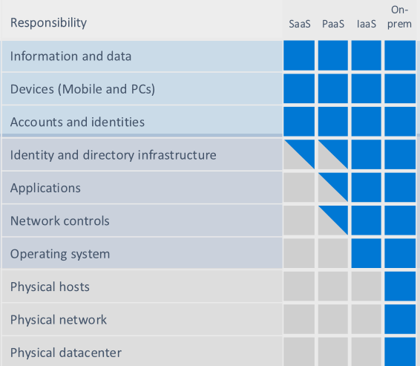


Microsoft Recommends Third-party Data Protection
Yet only 13% of businesses understand their role in safeguarding data¹
Microsoft shared responsibility model²
NetApp now offers customers Commvault’s SaaS line, Metallic 0365 backup.
This is in addition to the Commvault Complete Backup and Recovery.
Available for purchase by NetApp and NetApp channel partners. This combined offering provides full backup and recovery across the entire data fabric, using a simplified ordering process with a reduced number of SKUs
Customer
responsibility
Microsoft responsibility
Availability of Office 365 applications
Varies by
service type
Customer responsibility
Protecting their own data
Cloud provider responsibility
1 Source: ESG, The Evolution of Data Protection Cloud Strategies, 2021
2 https://docs.microsoft.com/en-us/azure/security/fundamentals/shared-responsibility
3 How does – or did your organization recover Office 365 data? (Percent of respondents, N- 296), ESG Research, Data Protection Cloud Strategies, June 2019
4 https://www.microsoft.com/en-us/servicesagreement
Notes:
When specifically relating to Microsoft365, it is highly recommended to have coordinated data protection for the enterprise. Yet, it has been noticed that a very small portion of businesses (only 13%) understand their own role in safeguarding their own data. Microsoft has a published a ‘shared responsibility model’. It is their recommendation to regularly backup the content and data that enterprise stores on their services. Read more about it in their service agreement : Shared responsibility in the cloud - Microsoft Azure | Microsoft Docs
Microsoft also highly recommends Commvault’s Metallic as their partner and a great option on Microsoft Azure marketplace. Make sure that your Microsoft365 data is recoverable from accidental deletion , corruption or malicious attacks with a SaaS backup and recovery solution from Commvault’s Metallic.
Commvault’s Metallic provides the tools you need to manage, migrate, access and recover your data no matter where it lives, while reducing cost and risk. Microsoft trusts Commvault Metallic to manage and protect some of its most important data and workloads. Commvault is proven and ready to help you harness the power of your data. Partnering with Microsoft Azure, Commvault Metallic SaaS Backup solution delivers data protection and recovery you can trust

Slide 7
Disaster Scenarios...
Doh! Deleted..
A month ago, your CEO accidentally deleted an email from their inbox. That email is permanently lost – as recycling bins have limited retention.
With Metallic from Commvault:
You can recover all active and deleted data from Metallic’s unlimited storage and retention.
My employee did what?
You discover a disgruntled employee hard deleted sensitive files, emails, and sites before resigning from your company. With Microsoft native controls, this data is gone forever.
With Metallic from Commvault:
You can easily roll data back to specific points in time.
The “R” word
You experience a ransomware attack that rapidly encrypts your all data. Your data is unusable because all redundant copies were encrypted.
With Metallic from Commvault:
Backup copies are store in air-gapped, isolated locations, so you quickly recover data (before encryption).
But I’ve got Legal Hold…
Your company is using Legal Hold, instead of dedicated backup and you must recover a critical user’s account. It can take days to restore this data, if at all!
With Metallic from Commvault:
You get automated protection for all users - to quickly restore files AND preserve the entire site structure.

Slide 8
TCO for Commvault’s SaaS line, Metallic
Less headaches, reduced overhead and only paying for what you need
The benefits of Commvault’s SaaS line, Metallic backup for Microsoft365
Infrastructure
No hardware, infrastructure, or large upfront capital expenditures
Administrative
time
Simplified deployment and management for administrations
Compute and network
Fully hosted, vendor managed network and bandwidth
Storage
Zero storage or egress fees – with unlimited Azure storage and retention built-in
Maintenance & support
Hassle-free software maintenance with automatic updates, product release and in-app support
Flexible subscriptions
Pay-as-you-go subscription model, with zero licensing fees

Slide 9
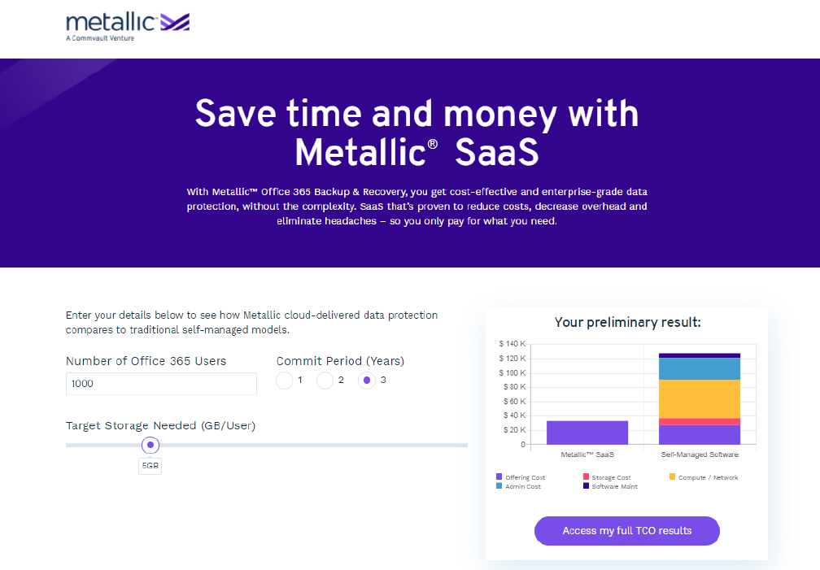
Try Our Microsoft365 TCO Calculator
See how Commvault’s SaaS line Metallic saves vs traditional self-managed solutions
See your personalized savings
Access detailed cost projections
Share your results
https://metallic.io/office365-tco-calculator

Slide 10
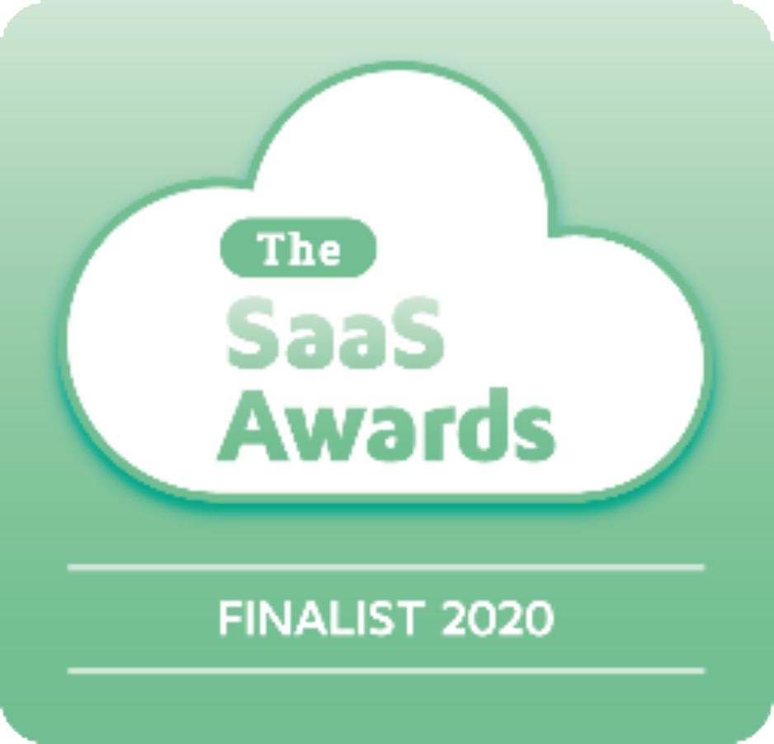
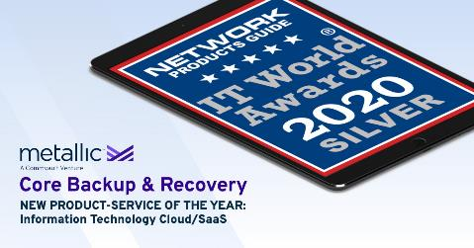
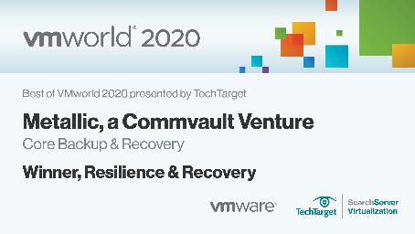

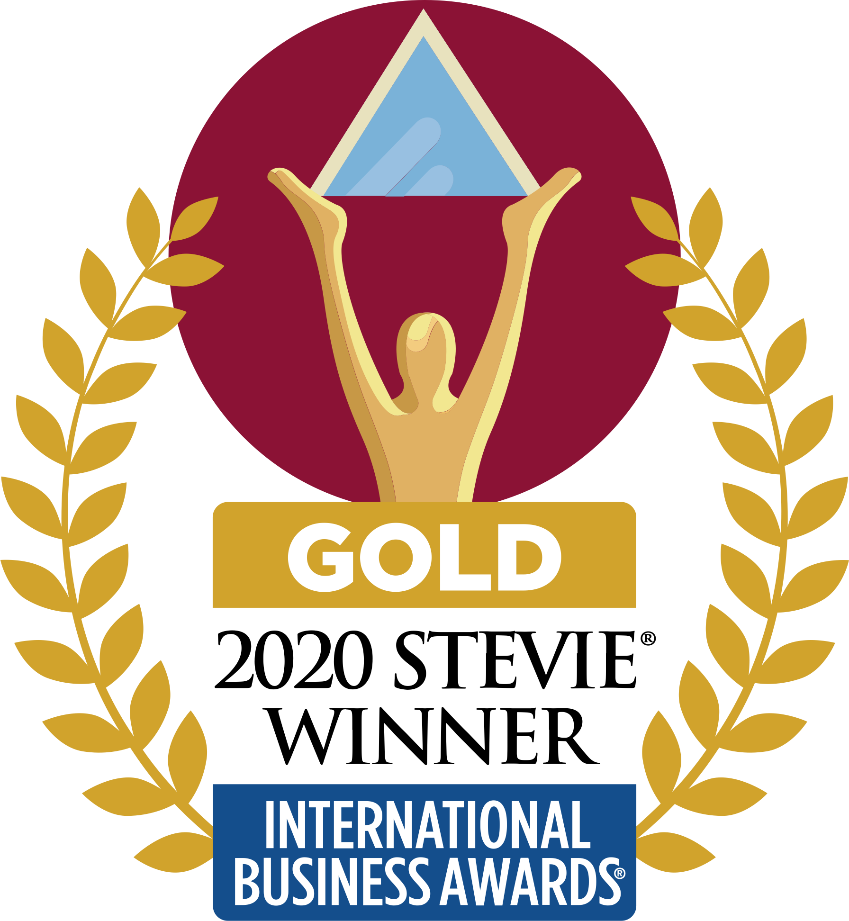
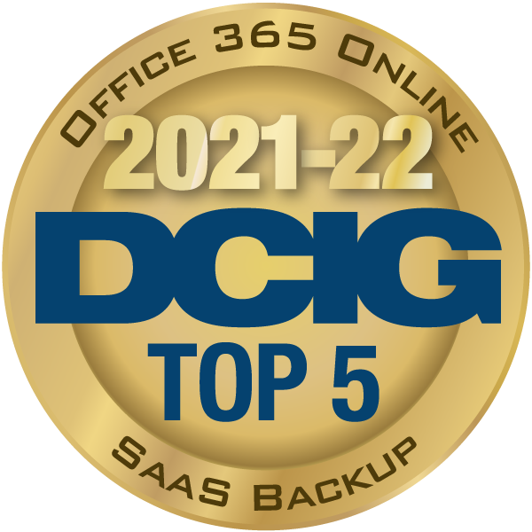


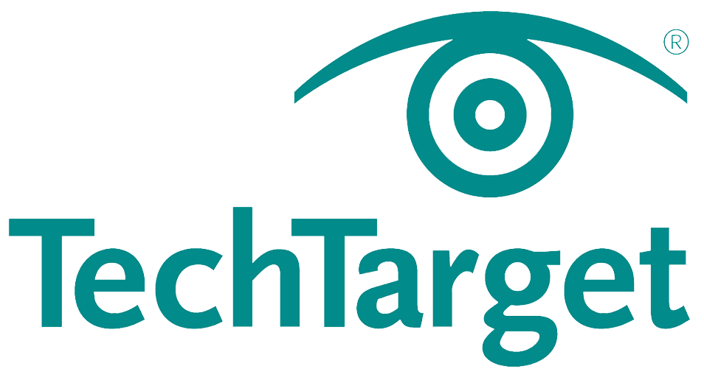
Commvault Metallic: Award Winning Technology
SaaS Awards Finalist
IT World Awards Winner
Best of VMWorld 2020
CRN
Gold Stevie’s Winner
DCIG
IT World Awards
TechTarget Infrastructure
“Cloud-based backup done right for a change…”
Notes:
While Commvault as a whole has been a recognized industry leader for over two decades, Metallic in its own right is turning heads and has snagged a number of industry awards – including a Gold Stevie.

Slide 11
Metallic Success Stories
Across use cases and industries
It runs in the background and it’s something that you install and then forget about … For me, it works great and it does exactly what it says it does.
We’re more efficient in all of our backups for Office 365 because it’s in a single pane of glass.
Benjamin Roper
Kristian Smith
Enterprise Backup & Recovery Specialist
Parsons
Technical Services & Support Manager
Linamar
We are able to have all of our backups in the cloud now, and were even able to leverage our existing Azure storage. With Metallic, we no longer manage and maintain physical hardware which makes us financially and even technically more efficient.
We originally purchased Metallic Office 365 Backup and have since expanded that deployment […] for File & Object and VM & Kubernetes Backup. The radical simplicity and unmatched scalability of Metallic is allowing us to completely rethink how we protect our data.
Jeff Day Smith
Peter Gregorowicz
Systems Technical Supervisor
State of Nevada DoT
Network Services Manager
Vancouver Community College
Notes:
But as much as we love the recognition from our peers, it’s our customers’ feedback that really matters.
Whatever the use case – and increasingly, for multiple use cases - customers are recognizing the impact Metallic can have on their business
From saving money, to driving efficiencies, to simplifying management, Metallic is making customers lives easier while keeping their data secure, compliant, and recoverable.
One customer recently summed it up: “The radical simplicity and unmatched scalability of Metallic is allowing us to completely rethink how we protect our data.”
<next>

Slide 12

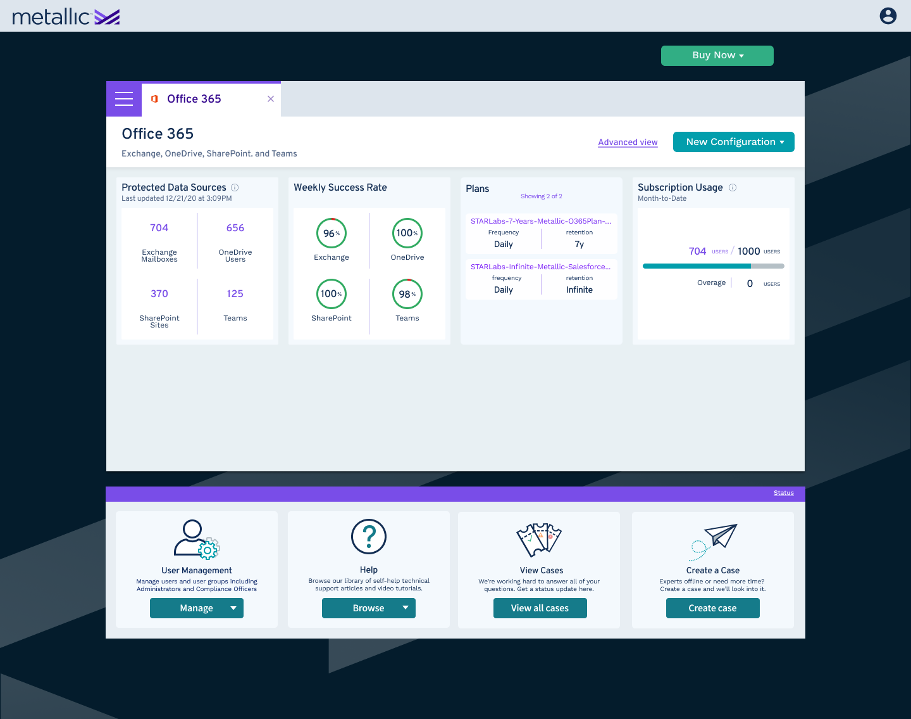
Trust Commvault’s SaaS line, Metallic for Microsoft365 Backup
Total protection for your Microsoft investment
Comprehensive coverage of Exchange, OneDrive, SharePoint, Teams, and more
Highly performant with granular search and flexible point-in-time/out-of-place restore options
All inclusive TCO via unlimited Azure storage with unlimited retention built-in
Robust controls, hardened security, and intuitive eDiscovery to meet SLA regulatory requirements
Notes:
Commvault’s Metallic SaaS Backup for Microsoft 365 protects the complete Exchange Online mailboxes, including all items and folders in primary, shared, and archive mailboxes, and OneDrive for Business files, folders, subfolders, permissions, and versions.
It also protects the enterprise SharePoint Online site collection, including all subsites, lists, libraries, and apps, along with workflows, permissions, versions, and look and feel. The business customer gets protection for Office 365 Groups and Microsoft Teams, including mailbox and site collections within them.
With deep protection, multi-layered security in the cloud, simple SaaS delivery with no hidden costs and going above and beyond to protect the business’s entire Microsoft cloud – this is a great solution for all related challenges

Slide 13
KUBERNETES DATA PROTECTION FOR GOVERNMENT AGENCIES

Slide 14
Protecting Containers and the
Future of Your Data Management
32%
of companies have containerized more than half of their applications
91%
organizations use Kubernetes to orchestrate containers
are deploying container based applications in combination of public cloud and private environments
believe that managing backup and recovery of container-based applications in hybrid environments is the biggest data protection challenge
71%
44%

Slide 15
Kubernetes Backup is Essential
Cybersecurity and ransomware attacks are on the rise and can cripple the organization
Accidental data loss is accelerated by automation and DevOps propagation of changes, including misconfigurations
Environmental failures can lead to disaster scenarios
Compliance and regulatory needs are overlooked and are key drivers for backing up Kubernetes applications
Application mobility and portability makes it important to adopt Kubernetes containers

Slide 16
5 Must Haves for Kubernetes Backup
Compliance based security prioritization – layered security, air-gapped defenses
Seamless hybrid cloud operations – a solution going across
on-prem and cloud environments, through a SaaS delivery model
Ease of operation – automatic application discovery, seamless integration, cohesive management features
Comprehensive protection – extending to Kubernetes while covering existing network infrastructure
Central management – reduced overall complexity and
a cloud forward perspective

Slide 17


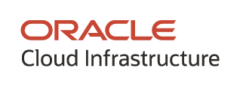




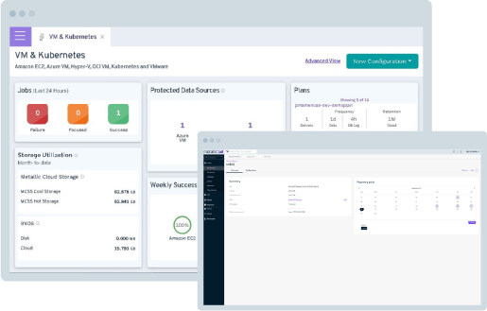
Commvault SaaS Line Metallic® Kubernetes Backup
From on-premises to cloud workloads, and cloud-native apps in containers, unified data protection from Metallic supports your entire hybrid cloud journey.
Essential DMaaS protection for hybrid workloads
Kubernetes Protection: enterprise-grade DMaaS protection for all CNCF-Certified Kubernetes distributions
Transparent: flexible pricing per instance,
single interface
Full Breadth: coverage across on-premises to cloud-native to support hybrid cloud environments

Slide 18
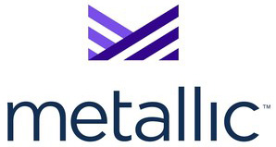
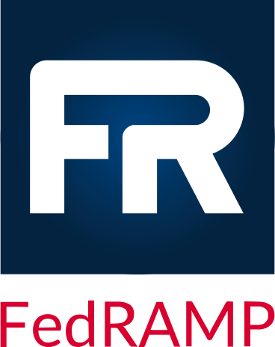

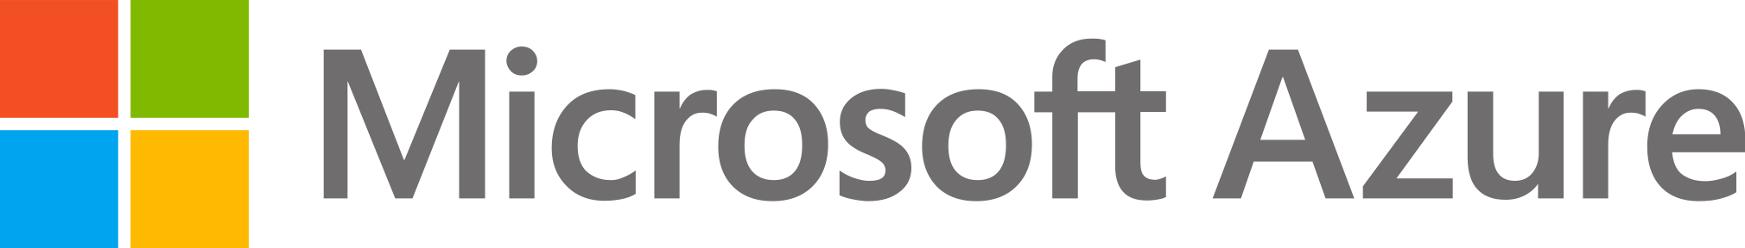
Commvault’s SaaS Line
Metallic® Government Cloud Solutions
The ONLY data protection portfolio to currently meet
FedRAMP High Ready and Azure Government standards*
+
Government Cloud
* Note: Metallic FedRAMP solutions are exclusively available on Azure Government Cloud and are not available on Azure Commercial Cloud at this time

Slide 19
Metallic® Government Cloud Solutions
Hosted exclusively on Microsoft Azure Government Cloud
FedRAMP High Ready
CJIS Compliant
FIPS 140-2 Compliant
SAAS APPLICATIONS
ENDPOINTS
Metallic Office 365 Backup^ †
Metallic Backup for Microsoft Dynamics 365^
Metallic
Salesforce Backup
Metallic
Endpoint Backup †
For SharePoint, Exchange, OneDrive, Teams, Project
For CRM applications
For production and sandbox environments
For laptops and desktops
HYBRID CLOUD DATA PROTECTION
CLOUD STORAGE
Metallic VM & Kubernetes Backup*
Metallic
Database Backup*
Metallic File & Object Backup
Metallic Cloud Storage Service
For VMware, Hyper-V, VMC, Azure VM, AWS, Kubernetes
For Microsoft SQL Servers, Active Directory, SAP HANA and Oracle
For Windows Server, Linux/UNIX, Azure Blob & Files
For long and short-term retention
^GCC High, † eDiscovery available, *Metallic Cloud Storage available as a storage target
Notes:
Metallic is Commvault’s line of SaaS –delivered solutions
It’s designed to help companies of all sizes – from hundreds to tens of thousands of employees -- reduce risk, safeguard against attack, and seamlessly navigate hybrid cloud environments with simplified management
– and today - our portfolio is more comprehensive than ever …
We offer backup and recovery for VMs and containers, as well as structured and unstructured data
We also protect SaaS applications – Office 365 and now Salesforce – with our latest addition to the family
And … we deliver powerful backup & recovery capabilities for laptops and desktops – which is more important than ever in this era of remote work.
Metallic provides companies peace of mind that while they’re getting the latest innovation in cloud-delivered backup, we’re built on the best -- with Commvault IP and the power of Microsoft Azure. “
Metallic is a solution built on trusted leadership from Commvault & the power of Azure – we are jointly making companies scalable, secure, and productive in the cloud … whatever their journey.”

